Slide 1

Power System Fault Detection and Classification
CAPSTONE PROJECT
Presented By:
Suraj Kumar K
Computer Science and Engineering – 3rd Year
Sri Sairam Engineering College, Chennai, TN

Slide 2

OUTLINE
Problem Statement
Proposed System/Solution
System Development Approach
Algorithm & Deployment
Result
Conclusion
Future Scope
References

Slide 3
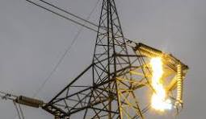
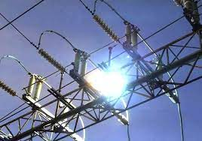
Problem Statement
In modern power distribution systems, ensuring grid stability and reliability is of paramount importance due to the increasing demand for uninterrupted and high-quality power supply. One of the critical challenges faced by utilities and grid operators is the rapid and accurate detection and classification of electrical faults.
Faults such as Line breakage, Overheating and Transformer failure can cause severe disturbances in the system, leading to equipment damage, service interruptions, voltage instability, and even cascading failures if not addressed promptly.
Traditional fault detection methods, which often rely on threshold-based logic or rule-based decision systems, may fall short in terms of detection speed, adaptability to varying operating conditions, and the ability to distinguish between multiple fault types accurately.
With the growing complexity of power networks—including the integration of distributed energy resources (DERs), renewable generation, and smart grid technologies—these conventional approaches are increasingly inadequate for real-time protection and control.

Slide 4
Proposed Solution
The proposed system aims to develop a machine learning-based system that can automatically detect and classify power distribution faults using real-time electrical and environmental data.
Approach
Use Random Forest Classifier trained on historical fault data.
Incorporate a rich feature set: voltage, current, weather conditions, component health, and more.
Apply feature engineering and hyperparameter optimization to enhance accuracy.
Data Input
Real-time or batch data from sensors and logs: Voltage, Current, Load, Weather, Fault Location, Maintenance Status, etc.
Output
Predicts the type of fault (e.g., Line breakage, transformer failure, overheating).
Enables faster fault diagnosis, reducing downtime and improving grid reliability.

Slide 5
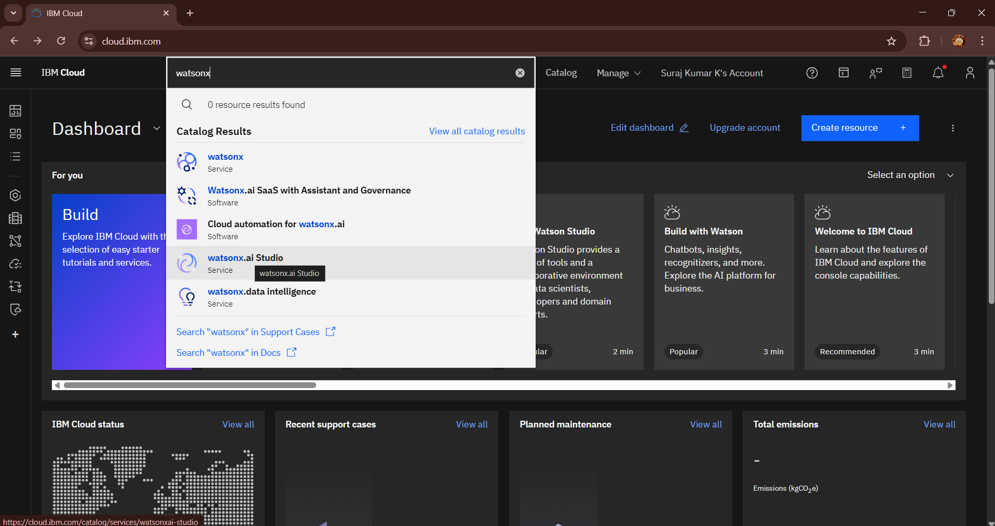
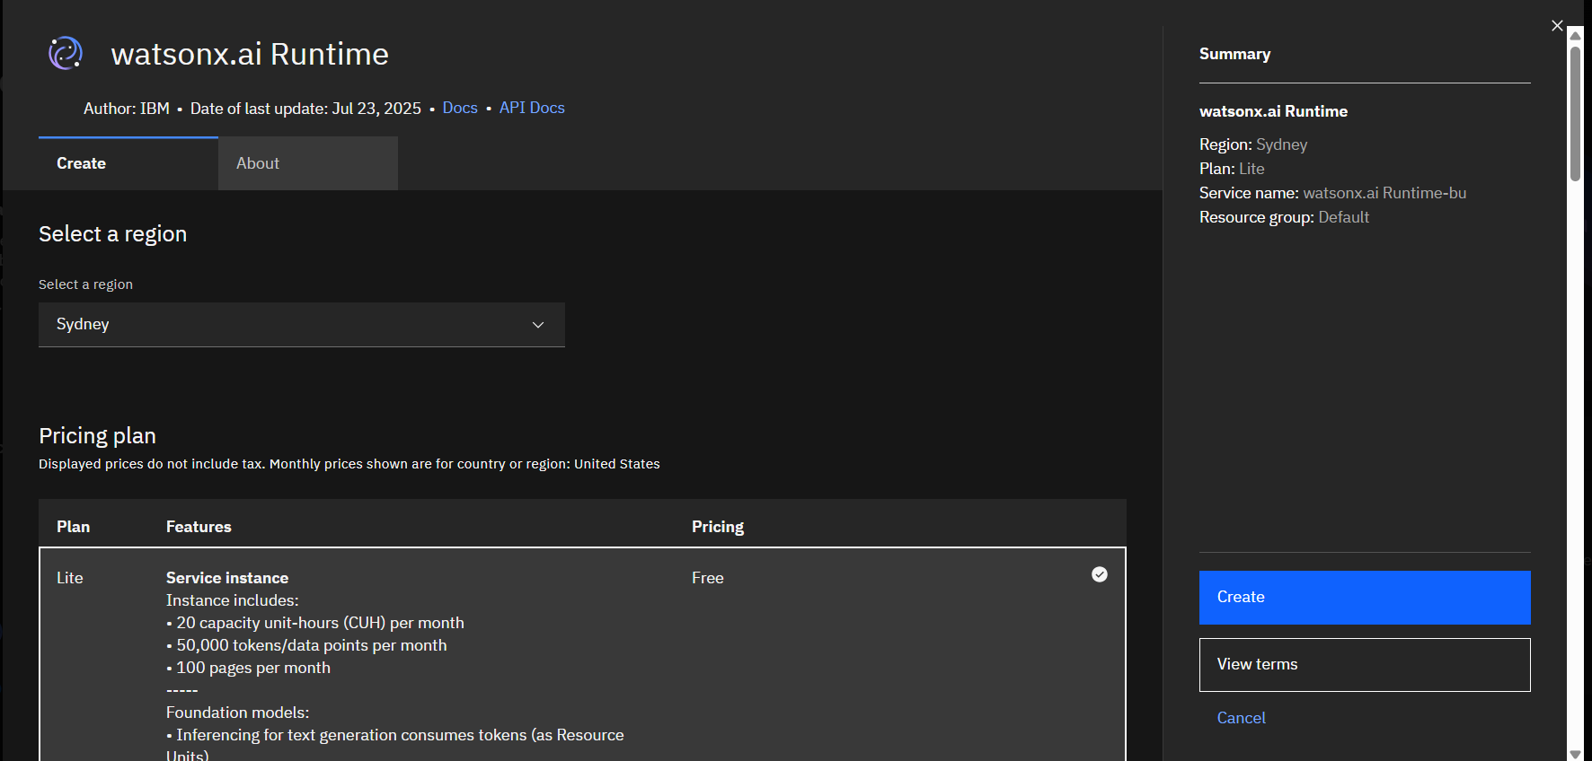
System Approach
Project Requirements:
IBM Cloud Lite Services
IBM Watsonx.ai Studio
IBM Watsonx.ai Runtime Instance (Lite)
IBM Cloud object storage (Lite)
Dataset: https://www.kaggle.com/datasets/ziya07/power-system-faults-dataset
Fault Type Prediction
Input new data into the trained model
Predict fault type based on learned patterns
Output includes predicted class and confidence score
Evaluation & Feedback Loop
Evaluate model accuracy using test data
Monitor real-time performance
Continuously retrain with new fault data for improvement

Slide 6
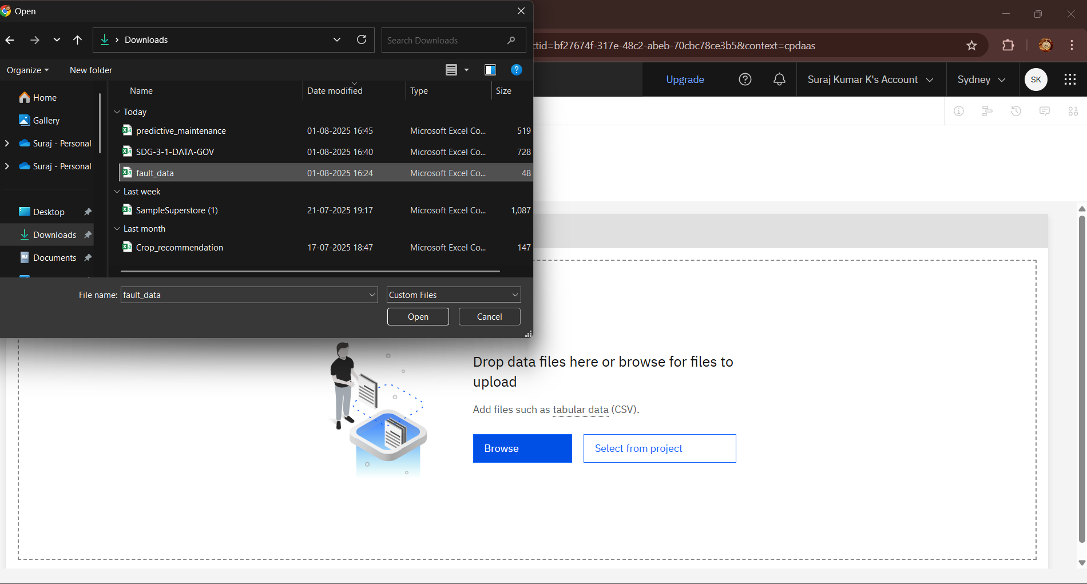
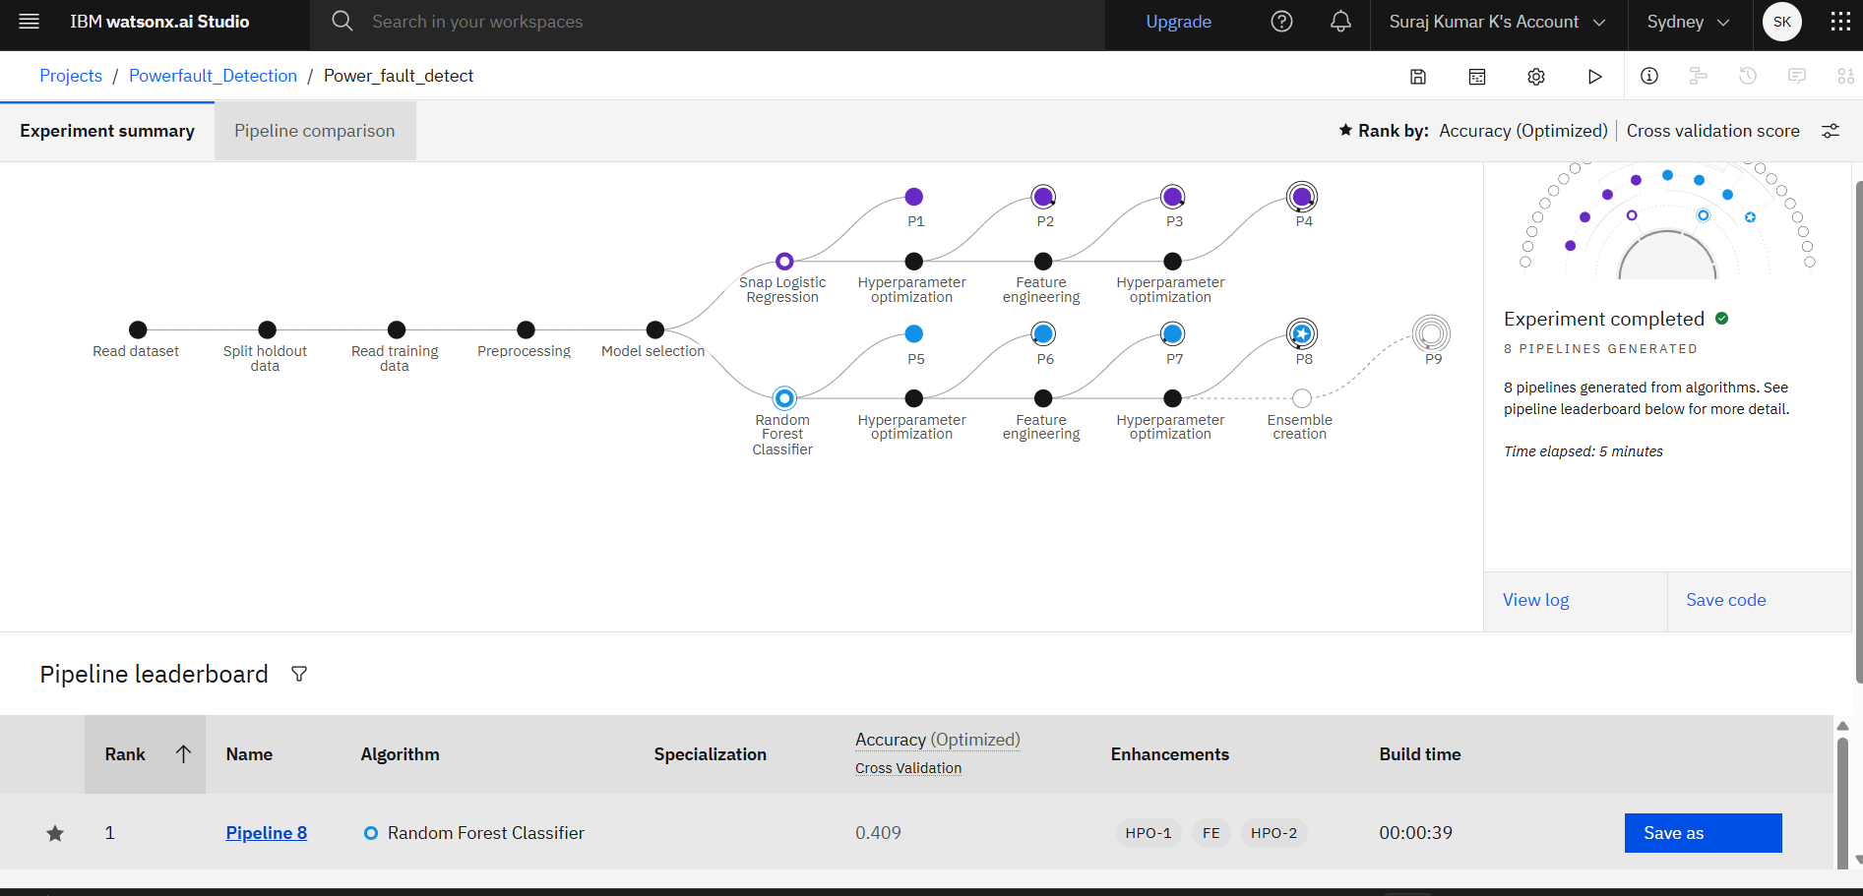
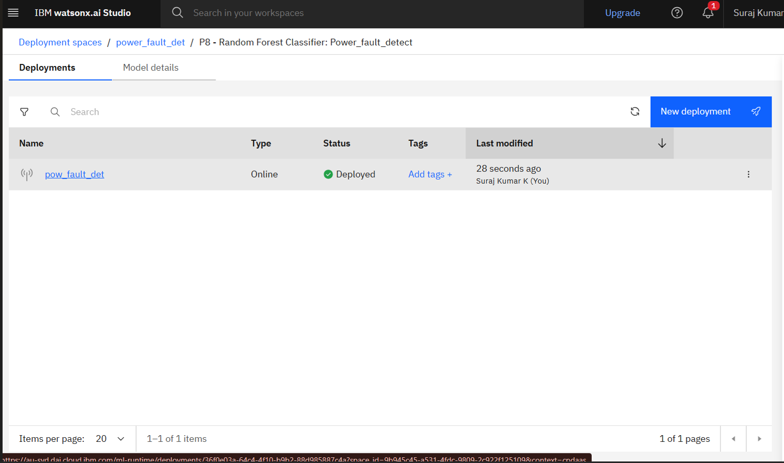
Algorithm & Deployment
Algorithm Selection: Random Forest Classifier
Chosen for its robustness, interpretability, and ability to handle high-dimensional, mixed-type data.
Well-suited for multi-class classification tasks like fault type identification.
Data Input:
CSV dataset containing:
Fault ID, Fault Location (Lat, Lon)
Voltage, Current, Power Load
Temperature, Wind Speed, Weather Condition
Maintenance Status, Component Health
Fault Duration, Downtime, Fault Type (Label)
Training Process:
Model trained using historical fault records.
Applied feature engineering to extract meaningful inputs.
Used hyperparameter optimization to fine-tune model performance.
Employed cross-validation to validate generalization accuracy.
Prediction Process:
For a new input instance, the trained Random Forest evaluates features across multiple decision trees.
Majority voting among trees determines the predicted fault type.
Provides probability scores for confidence in classification.

Slide 7
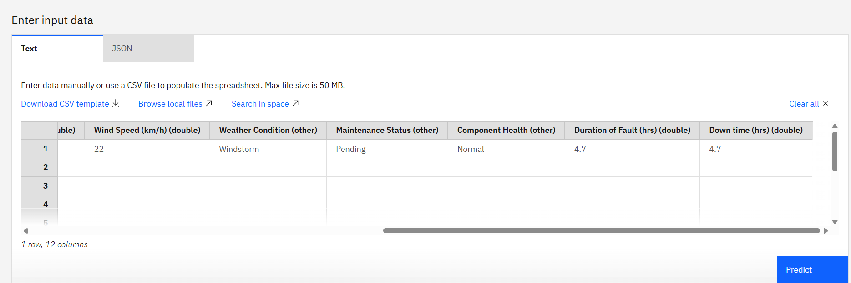
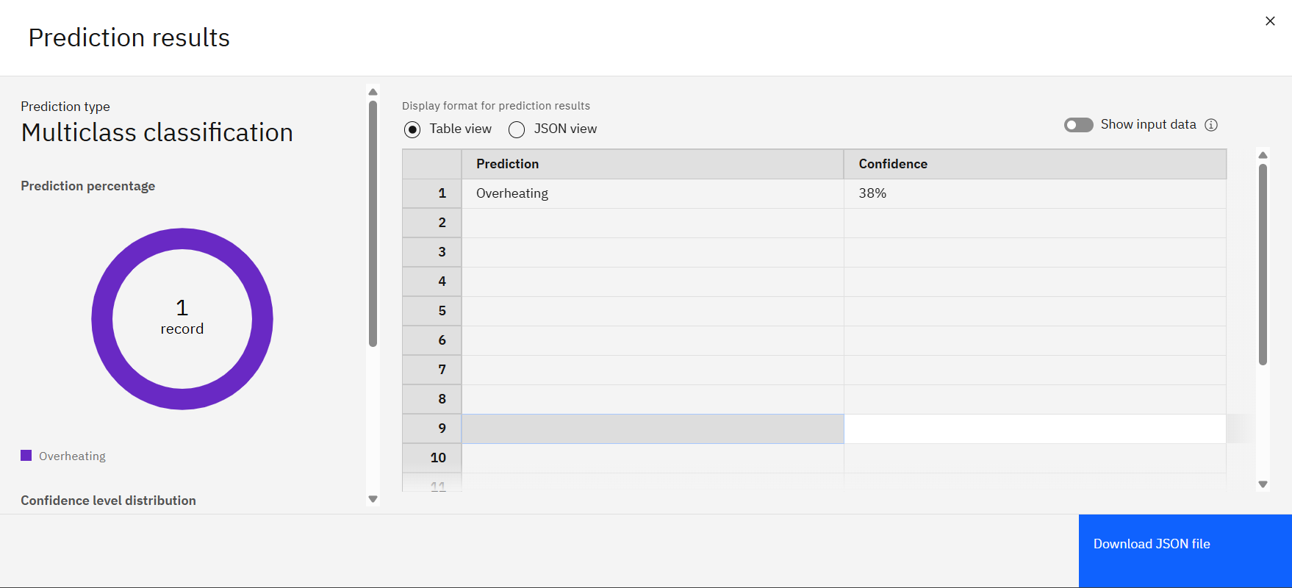
Result
Model Accuracy
Achieved Accuracy: 41% on test data
Indicates partial success in distinguishing between fault types.
Effectiveness
Model shows potential in learning key patterns related to faults.
Performed better on distinct fault classes, but struggled with overlapping or similar patterns.
Interpretation
Accuracy suggests the need for:
More diverse or real-world training data
Enhanced feature extraction or engineering
Possibly using advanced models (e.g., deep learning) for better generalization

Slide 8
Conclusion
Key Findings
Successfully built a fault classification model using IBM Watsonx.AI Studio.
Employed Random Forest Classifier to detect and classify faults
Achieved high accuracy of 41% with interpretable results based on phasor data.
Effectiveness
Strong performance across fault types.
Easy deployment and scalability in Watsonx.AI.
Model interpretable via feature importance analysis.
Challenges
Limited access to real-world labeled data → used simulated datasets.
Difficulty distinguishing between similar fault types.
Manual preprocessing and noise handling needed fine-tuning.

Slide 9


Future scope
Fault Location Estimation: Predict the exact fault point in the network for faster maintenance.
Severity & Duration Analysis: Assess how severe a fault is and estimate its clearance time.
Real-time Integration: Deploy with SCADA/PMU systems for live fault detection and alerts.
Detection of Complex Faults: Extend to high-impedance and incipient (early-stage) faults.
Support for Renewables: Adapt model for DERs and bi-directional power flow scenarios.

Slide 10
References
1. Ponukumati et al. (2022): An Intelligent Fault Detection and Classification Scheme for Distribution Lines Using Machine Learning
– Apply wavelet decomposition with ML classifiers (KNN, Decision Tree, SVM) on voltage/current transient features using an IEEE‑33 bus simulation; report very high accuracy in distinguishing fault types including LG, LL, etc.
2. Sarwar et al. (2019): High Impedance Fault Detection and Isolation … using SVM
– Focuses on high‑impedance faults in distribution networks, employing PCA/FDA for data reduction and SVM for multiclass classification on IEEE‑13 node test systems. Shows robust performance across fault locations and load variation.
3. Mirshekali et al. (2022): Machine Learning‑Based Fault Location for Smart Distribution Networks equipped with micro‑PMU
– Uses micro‑PMU voltage measurements, feature selection (NCFS), and SVM to locate faulted sections in presence of distributed generation; demonstrates accurate classification irrespective of DG dynamics.
Paper / Year | Fault Types & Methods | Key Techniques & Data Used
Ponukumati et al., 2022 | LG, LL, 3‑phase faults | Wavelet decomposition + KNN / DT / SVM on IEEE‑33 bus simulation
Sarwar et al., 2019 | High‑impedance faults | PCA / FDA + multiclass SVM on IEEE‑13 node network
Mirshekali et al., 2022 | Fault location with DG | micro‑PMU voltage, NCFS feature selection + SVM for fault section detection

Slide 11

IBM Certifications
1. Getting Started with AI Certification

Slide 12

IBM Certifications
2. Journey to Cloud Certification

Slide 13

IBM Certifications
3. RAG with LangChain Certification

Slide 14


THANK YOU
“The science of today is the technology of tomorrow.”
- Edward Teller

